Slide 1
OOPs in Python

Slide 2
What is OOP??
OOP stands for Object-Oriented Programming.
It mainly works on Class, Object, Polymorphism, Abstraction, Encapsulation and Inheritance. Its aim is to bind together the data and functions to operate on them.
Some of the well-known object-oriented languages are Objective C, Perl, Java, Python, Modula, Ada, Simula, C++, Smalltalk and some Common Lisp Object Standard.

Slide 3
Why oops ….????
We can build the programs from standard working modules that communicate with one another, rather than having to start writing the code from scratch which leads to saving of development time and higher productivity,
OOP language allows to break the program into the bit-sized problems that can be solved easily (one object at a time).
The new technology promises greater programmer productivity, better quality of software and lesser maintenance cost.
OOP systems can be easily upgraded from small to large systems.

Slide 4
Disadvantages of OOP
The length of the programmes developed using OOP language is much larger than the procedural approach.
We can not apply OOP everywhere as it is not a universal language.

Slide 5
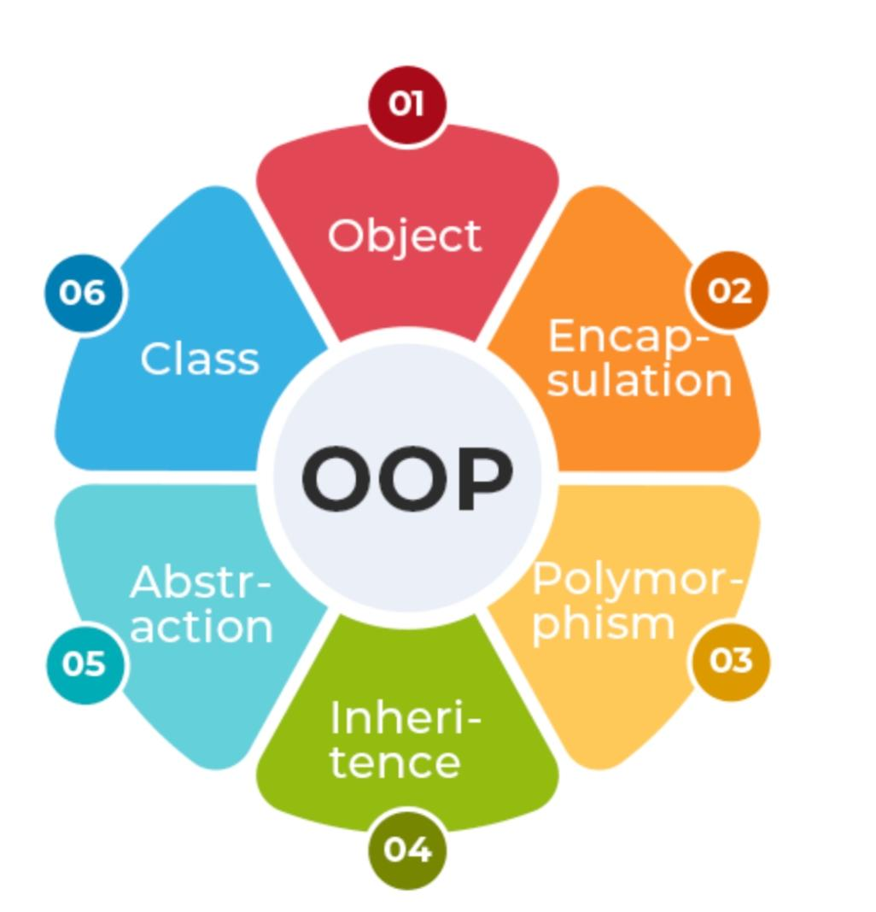
OOPs Concepts in Python
Class
Objects
Polymorphism
Encapsulation
Inheritance
Data Abstraction

Slide 6
Python Class
A class is a collection of objects. A class contains the blueprints or the prototype from which the objects are being created. It is a logical entity that contains some attributes and methods.
Creating a new class creates a new type of object, allowing new instances of that type to be made. Each class instance can have attributes attached to it for maintaining its state
Classes are created by keyword class. Attributes are the variables that belong to a class. Attributes are always public and can be accessed using the dot (.) operator. Eg.: Myclass.Myattribute

Slide 7
The class creates a user-defined data structure, which holds its own data members and member functions, which can be accessed and used by creating an instance of that class. A class is like a blueprint for an object.

Slide 8
Class Definition Syntax:
class ClassName: # Statement-1 . . . # Statement-N

Slide 9
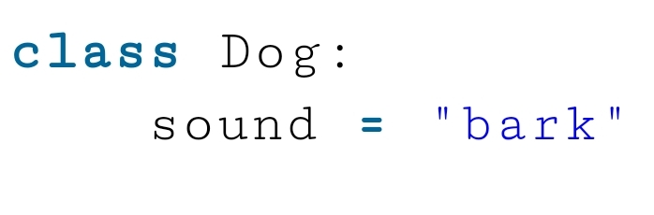
Creating an Empty Class in Python
# Python3 program to
# demonstrate defining
# a class
class Dog:
pass

Slide 10
Python Objects: An Object is an instance of a Class
A class is like a blueprint while an instance is a copy of the class with actual values
The object is an entity that has a state and behavior associated with it. It may be any real-world object like a mouse, keyboard, chair, table, pen, etc.
Integers, strings, floating-point numbers, even arrays, and dictionaries, are all objects.
More specifically, any single integer or any single string is an object. The number 12 is an object, the string “Hello, world” is an object, a list is an object that can hold other objects, and so on.

Slide 11
An object of python class consists of:
State: It is represented by the attributes of an object. It also reflects the properties of an object.
Behavior: It is represented by the methods of an object. It also reflects the response of an object to other objects.
Identity: It gives a unique name to an object and enables one object to interact with other objects.

Slide 12
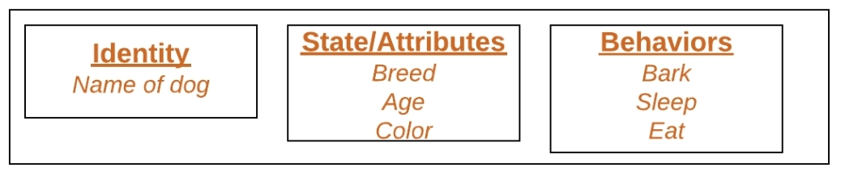
To understand the state, behavior, and identity let us take the example of the class dog (explained above).
The identity can be considered as the name of the dog.
State or Attributes can be considered as the breed, age, or color of the dog.
The behavior can be considered as to whether the dog is eating or sleeping

Slide 13
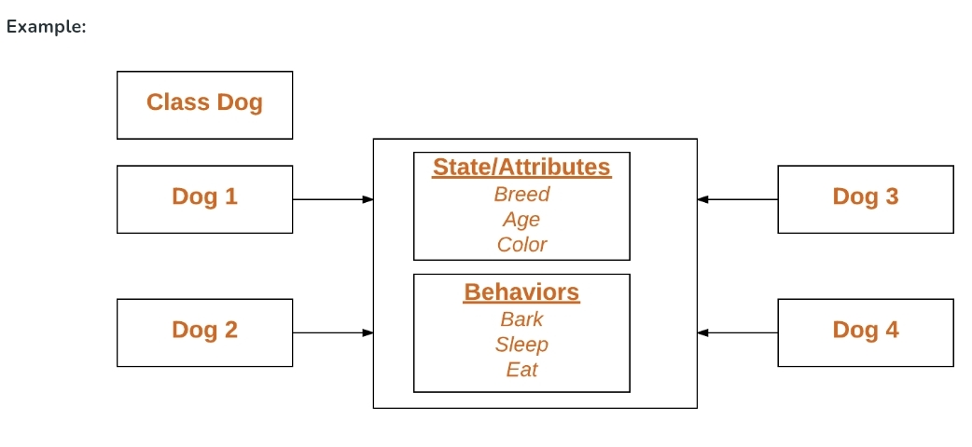
Declaring Claas Objects (Also called instantiating a class)
When an object of a class is created, the class is said to be instantiated. All the instances share the attributes and the behavior of the class. But the values of those attributes, i.e. the state are unique for each object. A single class may have any number of instances.

Slide 14
Creating an Object
This will create an object named obj of the class Dog defined above.
Before diving deep into objects and classes let us understand some basic keywords that will we used while working with objects and classes.
Obj = Dog()

Slide 15
The Python self
Class methods must have an extra first parameter in the method definition. We do not give a value for this parameter when we call the method, Python provides it
If we have a method that takes no arguments, then we still have to have one argument.
This is similar to this pointer in C++ and this reference in Java.
Self represents the instance of the class. By using the “self” we can access the attributes and methods of the class in Python. It binds the attributes with the given arguments.
When we call a method of this object as myobject.method(arg1, arg2), this is automatically converted by Python into MyClass.method(myobject, arg1, arg2) – this is all the special self is about.

Slide 16
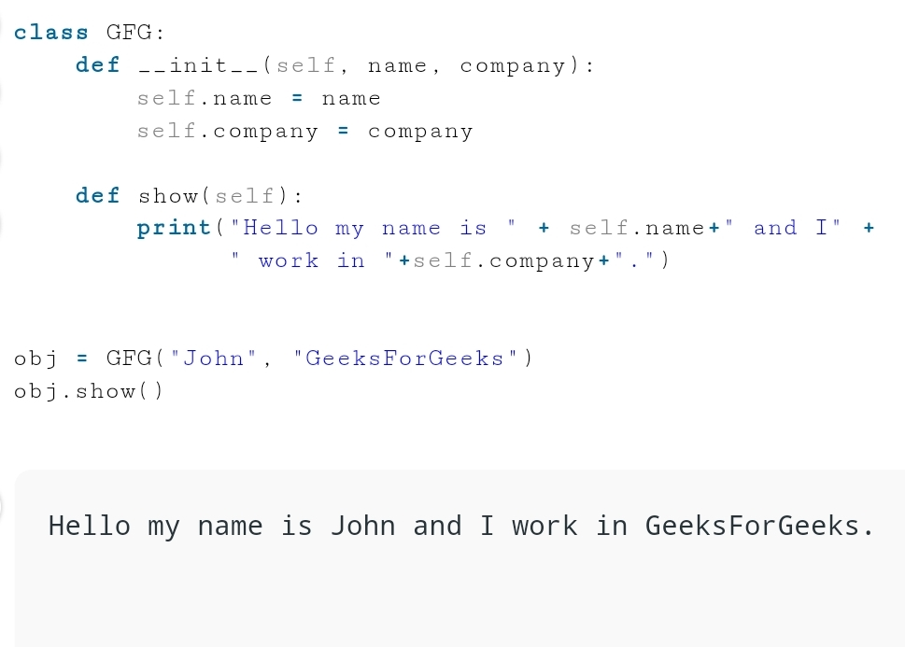

Slide 17
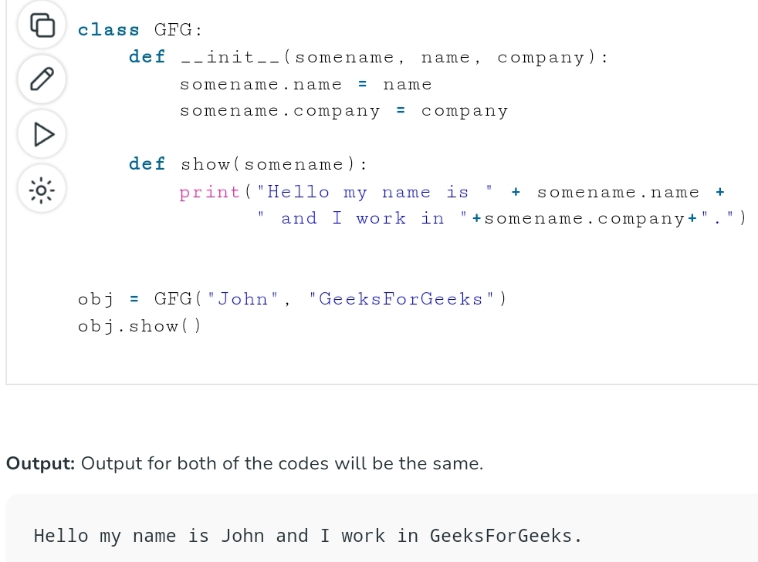
When an object of a class is created, the class is said to be instantiated. All the instances share the attributes and the behavior of the class. But the values of those attributes, i.e. the state are unique for each object. A single class may have any number of instances.

Slide 18
Explanation:
In this example, we are creating a GFG class and we have created the name, and company instance variables in the constructor. We have created a method named say_hi() which returns the string “Hello my name is ” + {name} +” and I work in “+{company}+”.”.We have created a person class object and we passing the name John and Company GeeksForGeeks to the instance variable. Finally, we are calling the show() of the class.

Slide 19
What is the use of self in Python?
When working with classes in Python, the term “self” refers to the instance of the class that is currently being used. It is customary to use “self” as the first parameter in instance methods of a class. Whenever you call a method of an object created from a class, the object is automatically passed as the first argument using the “self” parameter. This enables you to modify the object’s properties and execute tasks unique to that particular instance.

Slide 20
Is self in Python a Keyword?
No, ‘ self ‘ is not a keyword in Python. Self is just a parameter name used in instance methods to refer to the instance itself.
The self is always pointing to the Current Object. When you create an instance of a class, you’re essentially creating an object with its own set of attributes and methods.

Slide 21
The Python __init__ Method
The Default __init__ Constructor in C++ and Java. Constructors are used to initializing the object’s state. The task of constructors is to initialize(assign values) to the data members of the class when an object of the class is created. Like methods, a constructor also contains a collection of statements(i.e. instructions) that are executed at the time of Object creation. It is run as soon as an object of a class is instantiated. The method is useful to do any initialization you want to do with your object.

Slide 22
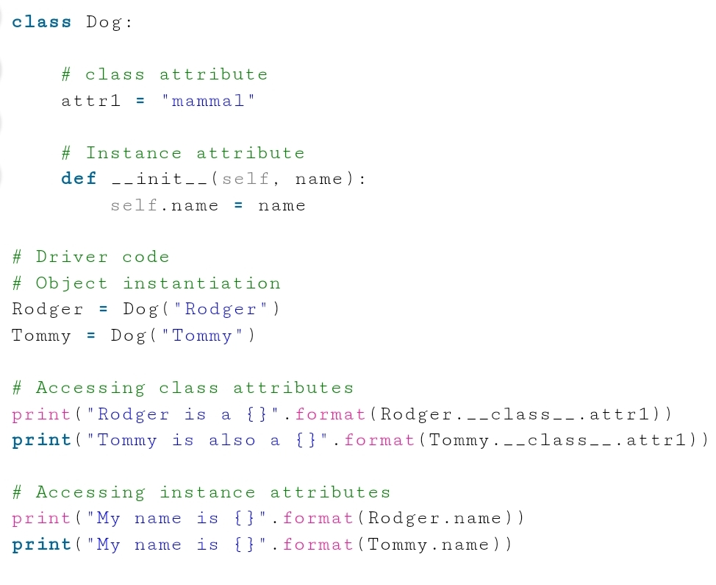
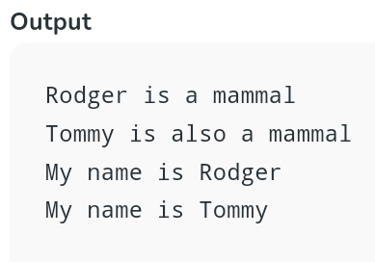
Creating a class and object with class and instance attributes

Slide 23
Creating Classes and objects with methods
Here, The Dog class is defined with two attributes:
attr1 is a class attribute set to the value “mammal”. Class attributes are shared by all instances of the class.
__init__ is a special method (constructor) that initializes an instance of the Dog class. It takes two parameters: self (referring to the instance being created) and name (representing the name of the dog). The name parameter is used to assign a name attribute to each instance of Dog. The speak method is defined within the Dog class. This method prints a string that includes the name of the dog instance.

Slide 24
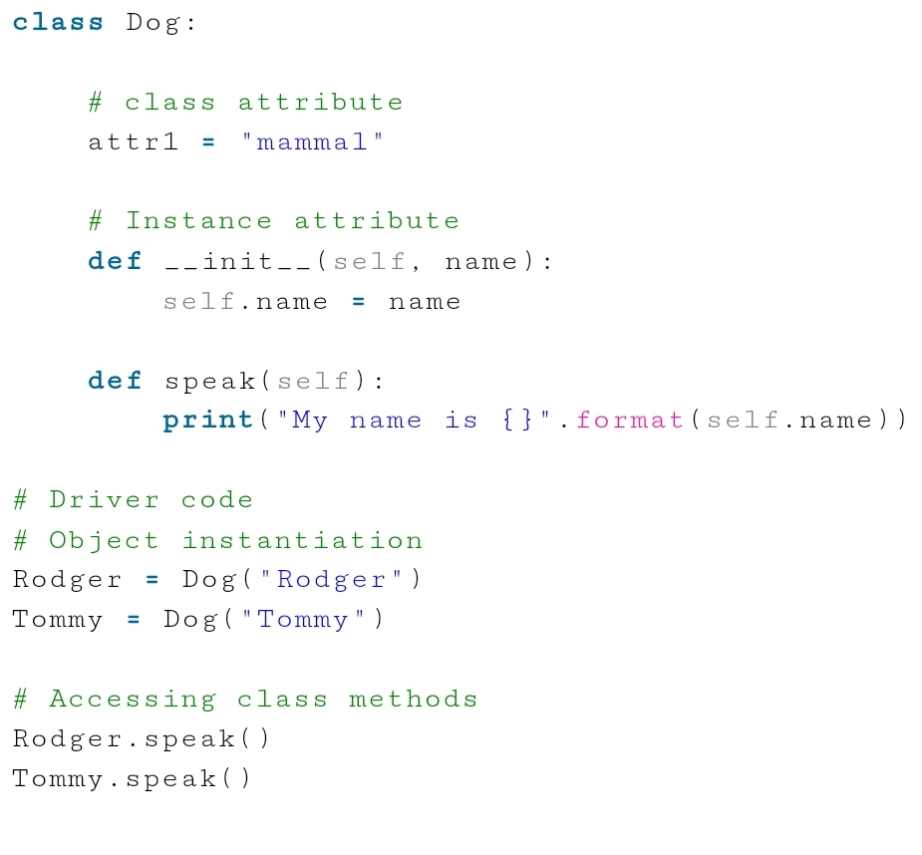
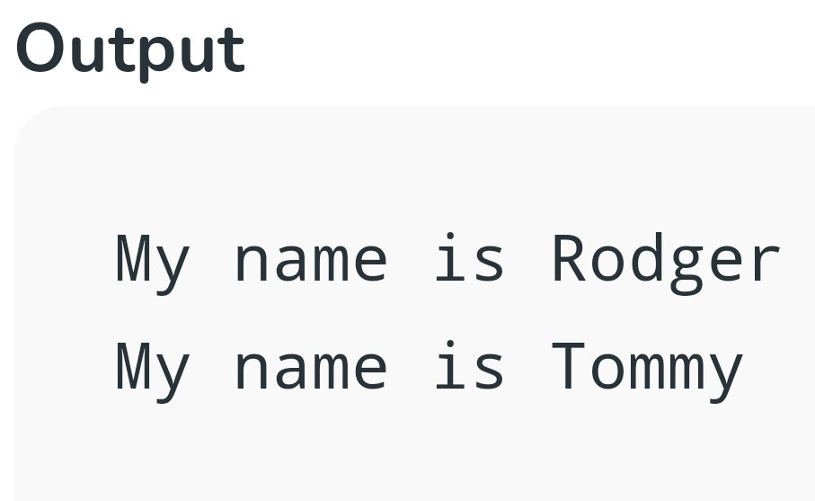
The driver code starts by creating two instances of the Dog class: Rodger and Tommy. The __init__ method is called for each instance to initialize their name attributes with the provided names. The speak method is called in both instances (Rodger.speak() and Tommy.speak()), causing each dog to print a statement with its name.

Slide 25
Python Inheritance
Inheritance is the capability of one class to derive or inherit the properties from another class. The class that derives properties is called the derived class or child class and the class from which the properties are being derived is called the base class or parent class. The benefits of inheritance are:
It represents real-world relationships well.
It provides the reusability of a code. We don’t have to write the same code again and again. Also, it allows us to add more features to a class without modifying it.
It is transitive in nature, which means that if class B inherits from another class A, then all the subclasses of B would automatically inherit from class A.

Slide 26
Benefits of inheritance are:
Inheritance allows you to inherit the properties of a class, i.e., base class to another, i.e., derived class. The benefits of Inheritance in Python are as follows:
It represents real-world relationships well.
It provides the reusability of a code. We don’t have to write the same code again and again. Also, it allows us to add more features to a class without modifying it.
It is transitive in nature, which means that if class B inherits from another class A, then all the subclasses of B would automatically inherit from class A.
Inheritance offers a simple, understandable model structure.
Less development and maintenance expenses result from an inheritance.

Slide 27
Types of Inheritance
Single Inheritance: Single-level inheritance enables a derived class to inherit characteristics from a single-parent class.
Multilevel Inheritance: Multi-level inheritance enables a derived class to inherit properties from an immediate parent class which in turn inherits properties from his parent class.
Hierarchical Inheritance: Hierarchical-level inheritance enables more than one derived class to inherit properties from a parent class.
Multiple Inheritance: Multiple-level inheritance enables one derived class to inherit properties from more than one base class.

Slide 28
Python Inheritance Syntax
Class BaseClass:
{Body}
Class DerivedClass(BaseClass):
{Body}

Slide 29
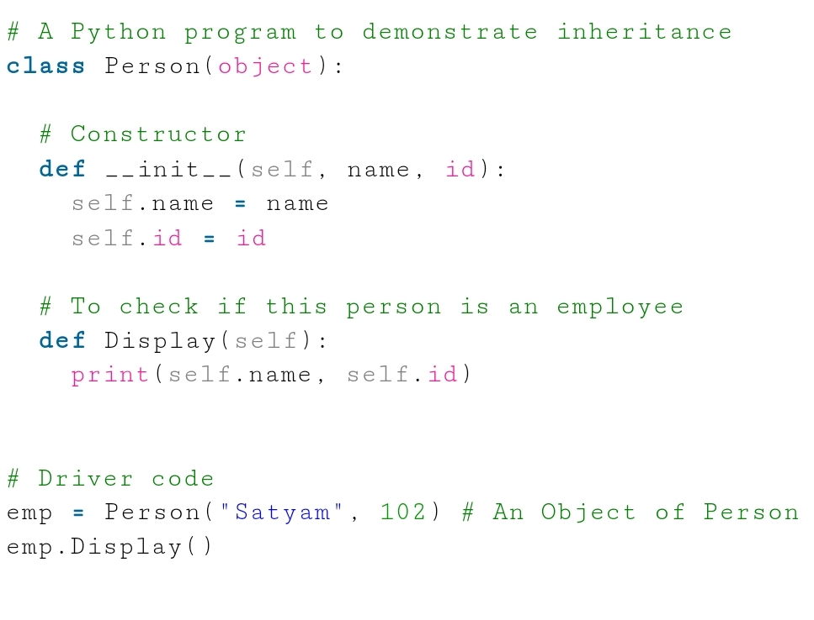
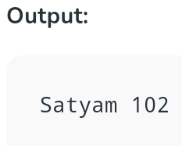
Creating a Parent Class
A parent class is a class whose properties are inherited by the child class. Let’s create a parent class called Person which has a Display method to display the person’s information.

Slide 30
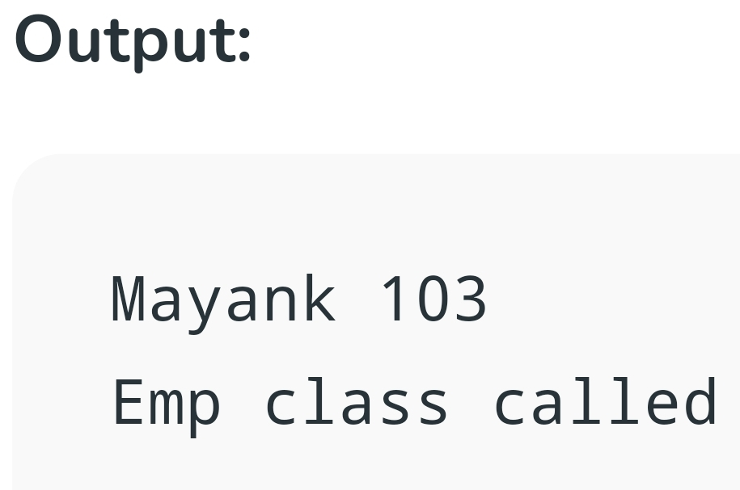
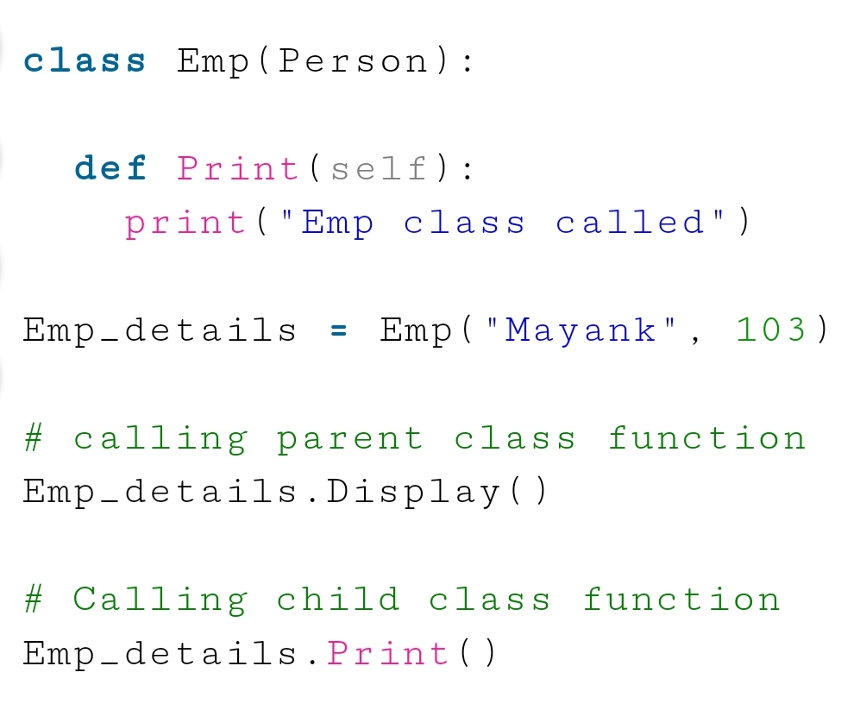
Creating a Child Class
A child class is a class that drives the properties from its parent class. Here Emp is another class that is going to inherit the properties of the Person class(base class).

Slide 31
Example of Inheritance in Python
Let us see an example of simple Python inheritance in which a child class is inheriting the properties of its parent class. In this example, ‘Person’ is the parent class, and ‘Employee’ is its child class.

Slide 32
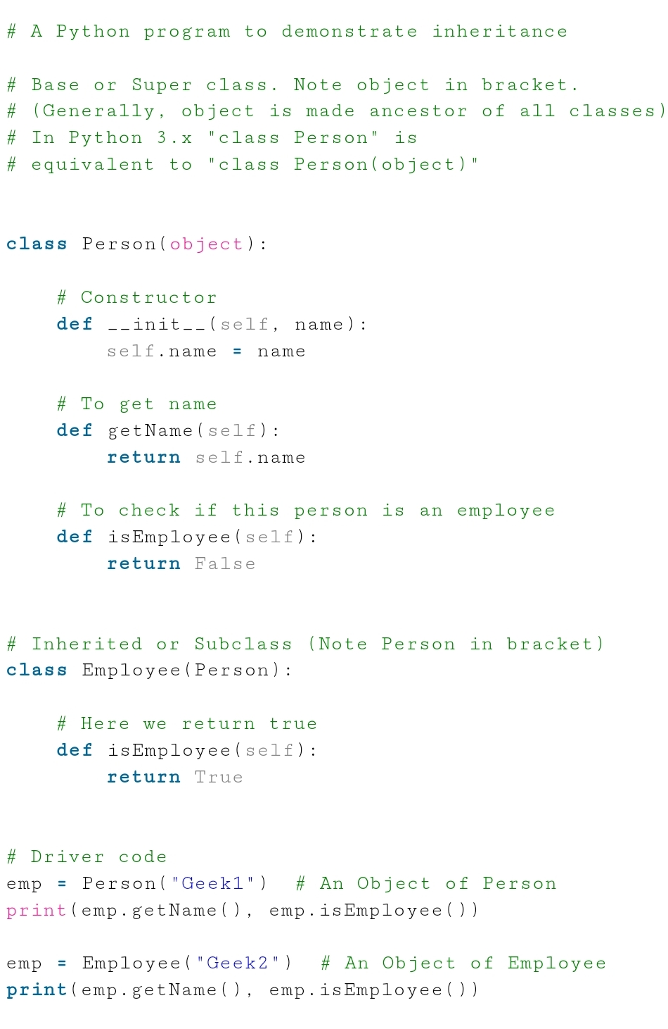
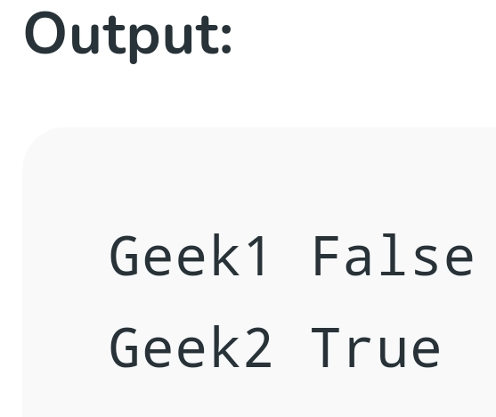

Slide 33
Overloading & Overriding
Method overloading allows multiple methods in the same class to have the same name but different parameters. Method overriding allows a parent class and a child class to have methods with the same name and same parameters.
The child class method will override the parent class method.

Slide 34
Method Overloading:
Method Overloading is an example of Compile time polymorphism.
In this, more than one method of the same class shares the same method name having different signatures. Method overloading is used to add more to the behavior of methods and there is no need of more than one class for method overloading.

Slide 35
Two or more methods have the same name but different numbers of parameters or different types of parameters, or both. These methods are called overloaded methods and this is called method overloading.
Like other languages (for example, method overloading in C++) do, python does not support method overloading by default. But there are different ways to achieve method overloading in Python
The problem with method overloading in Python is that we may overload the methods but can only use the latest defined method

Slide 36
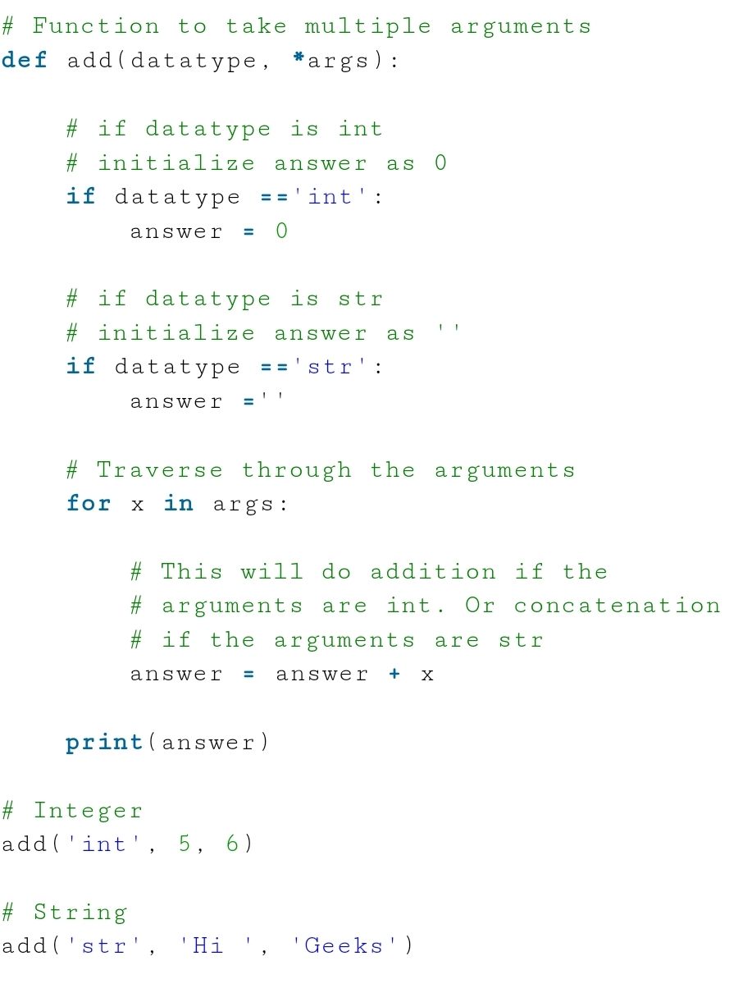
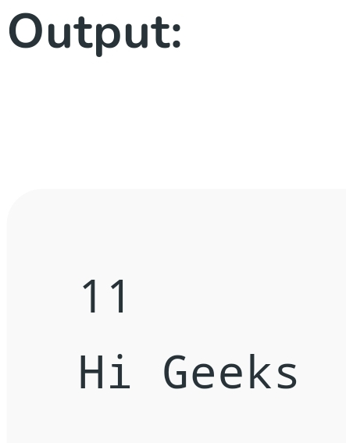

Slide 37
Method Overriding in Python
Method overriding is an ability of any object-oriented programming language that allows a subclass or child class to provide a specific implementation of a method that is already provided by one of its super-classes or parent classes. When a method in a subclass has the same name, same parameters or signature and same return type(or sub-type) as a method in its super-class, then the method in the subclass is said to override the method in the super-class.

Slide 38
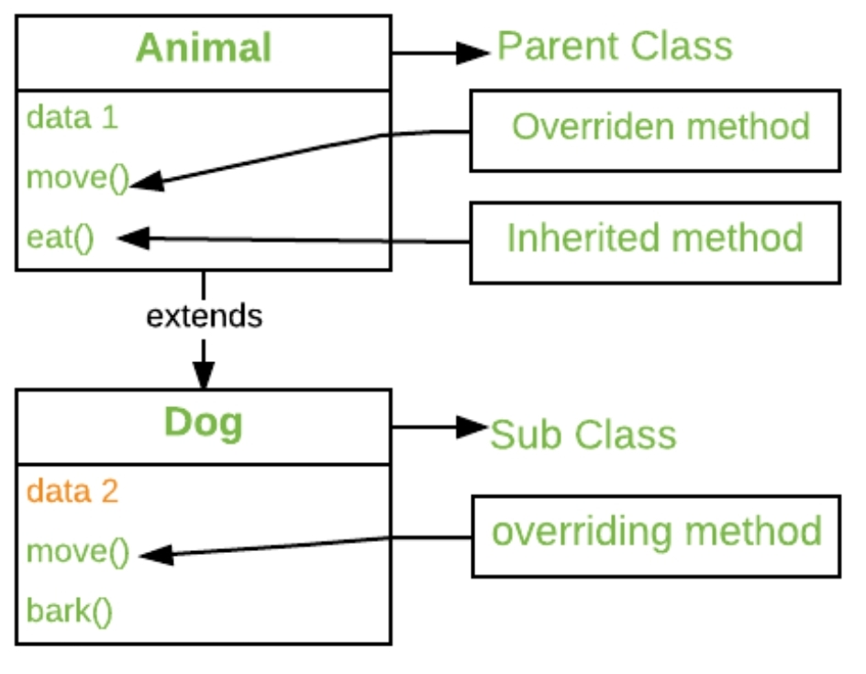
The version of a method that is executed will be determined by the object that is used to invoke it. If an object of a parent class is used to invoke the method, then the version in the parent class will be executed, but if an object of the subclass is used to invoke the method, then the version in the child class will be executed. In other words, it is the type of the object being referred to (not the type of the reference variable) that determines which version of an overridden method will be executed.

Slide 39
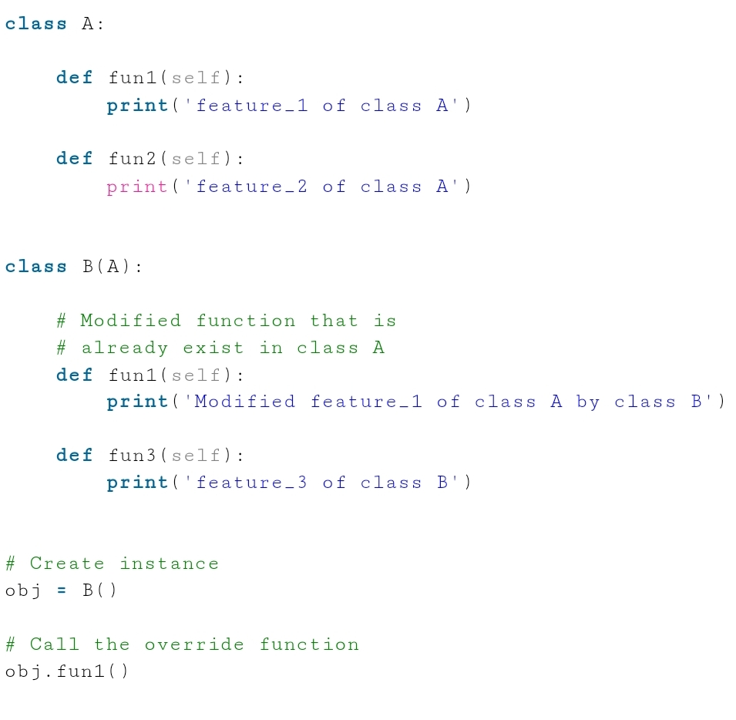
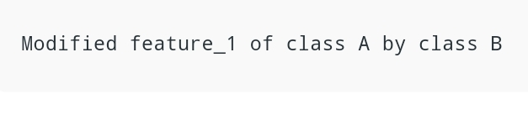
Output:

Slide 40
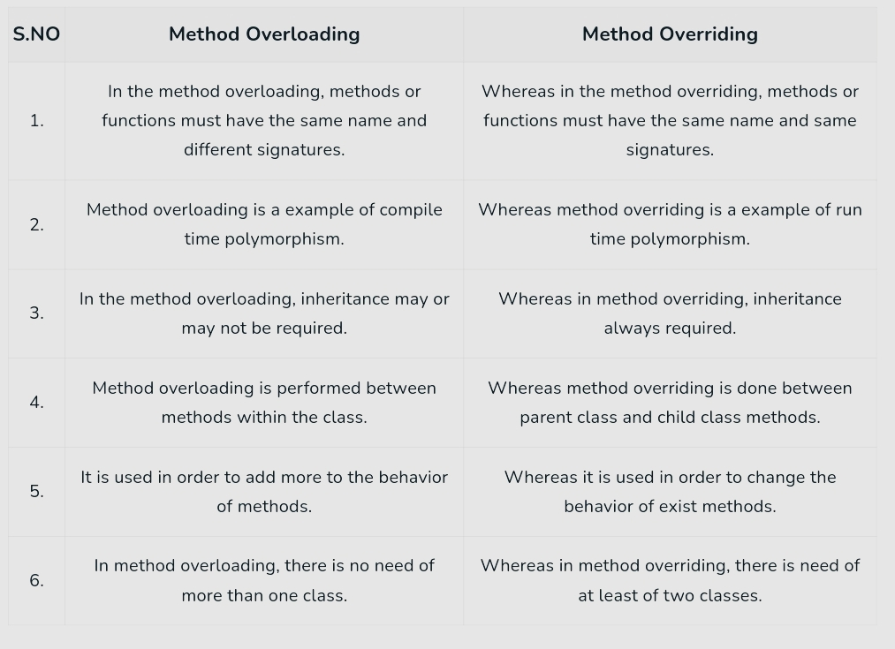

Slide 41
Data Hiding
Data hiding is a concept which underlines the hiding of data or information from the user. It is one of the key aspects of Object-Oriented programming strategies. It includes object details such as data members, internal work. Data hiding excludes full data entry to class members and defends object integrity by preventing unintended changes

Slide 42
Data Hiding in Python:
The Python document introduces Data Hiding as isolating the user from a part of program implementation. Some objects in the module are kept internal, unseen, and unreachable to the user. Modules in the program are easy enough to understand how to use the application, but the client cannot know how the application functions.
Thus, data hiding imparts security, along with discarding dependency. Data hiding in Python is the technique to defend access to specific users in the application
Data hiding in Python is performed using the __ double underscore before done prefix. This makes the class members non-public and isolated from the other classes.
Data hiding in Python is performed using the __ double underscore before done prefix. This makes the class members non-public and isolated from the other classes.

Slide 43
Advantages of Data Hiding:
It helps to prevent damage or misuse of volatile data by hiding it from the public.
The class objects are disconnected from the irrelevant data.
It isolates objects as the basic concept of OOP.
It increases the security against hackers that are unable to access important data.

Slide 44
Disadvantages of Data Hiding:
It enables programmers to write lengthy code to hide important data from common clients.
The linkage between the visible and invisible data makes the objects work faster, but data hiding prevents this linkage.

Slide 45
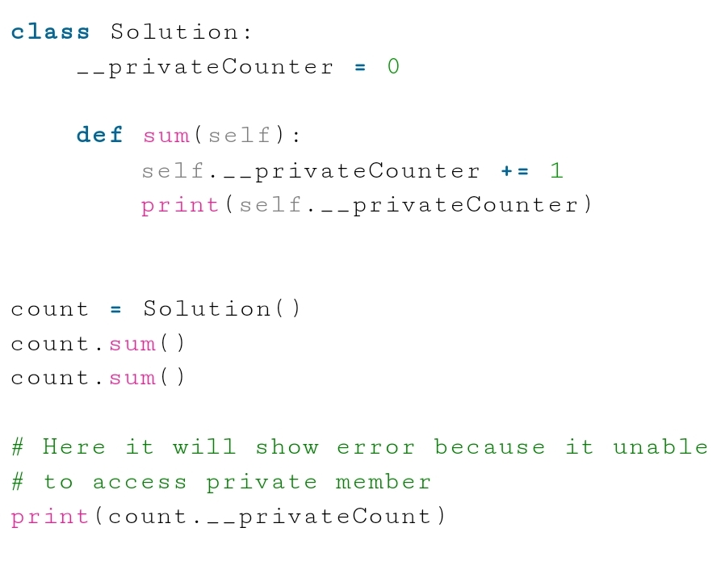
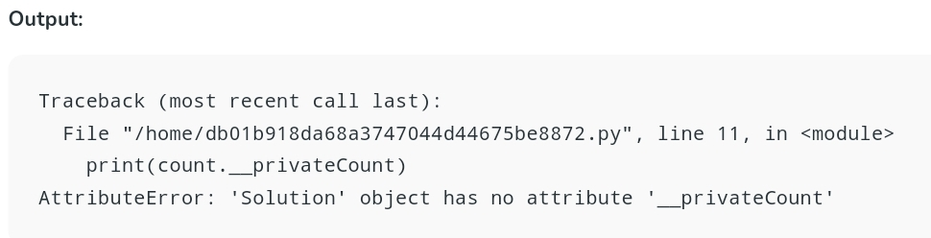

Slide 46
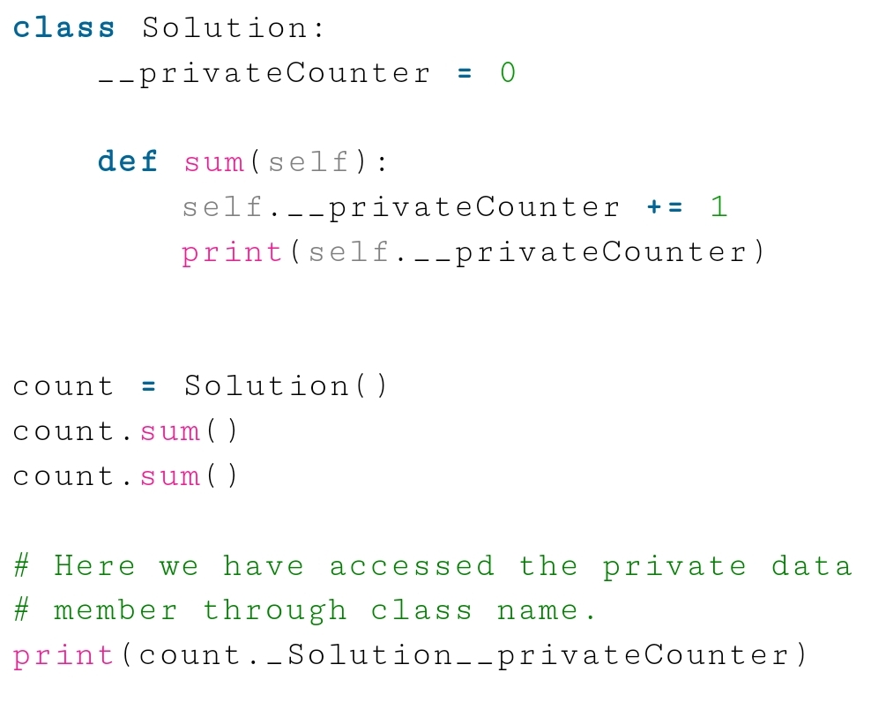
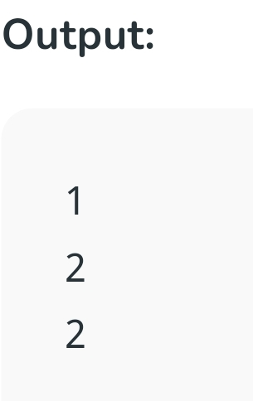
To rectify the error, we can access the private member through the class name :

Slide 47
Thank you!

